Slide 1

Laptop Price Prediction
By :-
Kathan Teldhune
Sai Kiran Earla
S Parashivamurthi Chavan

Slide 2
Introduction
This project is based on laptop price prediction, where we classify the laptop price based on the specifications of the laptop.
The goal of this project is to accurately predict the prices of laptops based on the various features.

Slide 3
Agenda
Problem Statement
Data Mining
Data Cleaning
Data Visualization
Feature Engineering
Predictive Modeling

Slide 4
DATA
VISUALIZATION

Slide 5
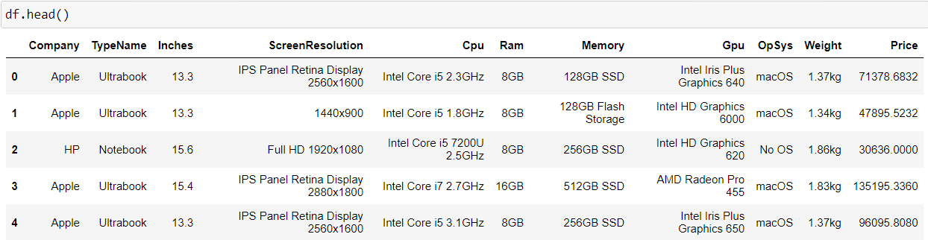
Problem Statement
Attribute Information
The problem statement is that if a customer wishes to buy a laptop, our model should be able to deliver a preliminary price based on the user's parameters. Despite the fact that it appears to be a basic project or a growing model, the dataset we have is raw and requires extensive feature engineering.

Slide 6
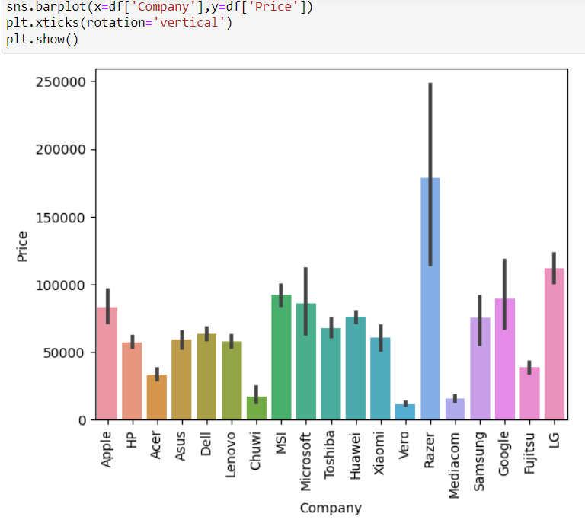
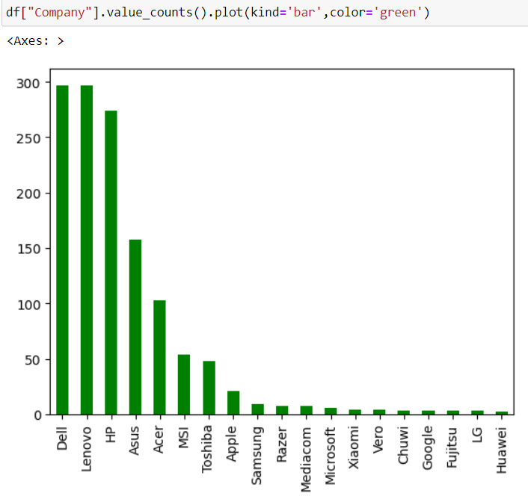
Comparing the Company column with the Target column(Price)

Slide 7
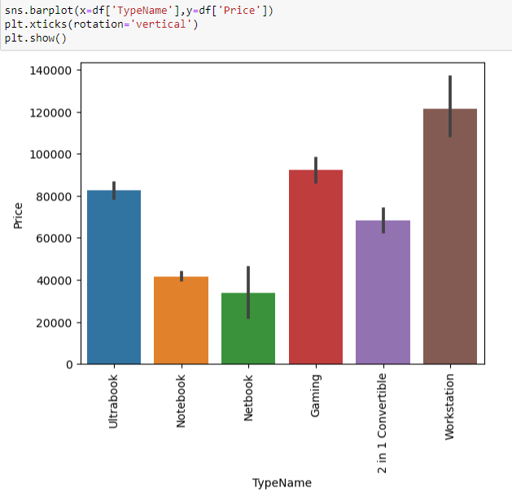
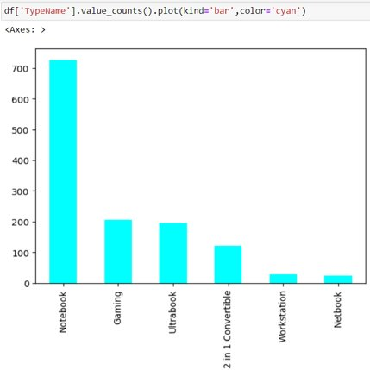
Comparing TypeName column with the Target column.

Slide 8
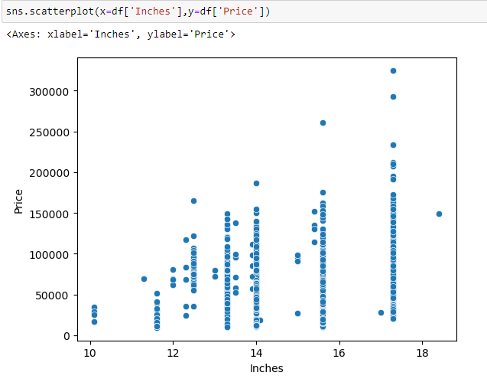
Plotting a scatterplot of Inches column with the Target column

Slide 9
FEATURE
ENGINEERING

Slide 10
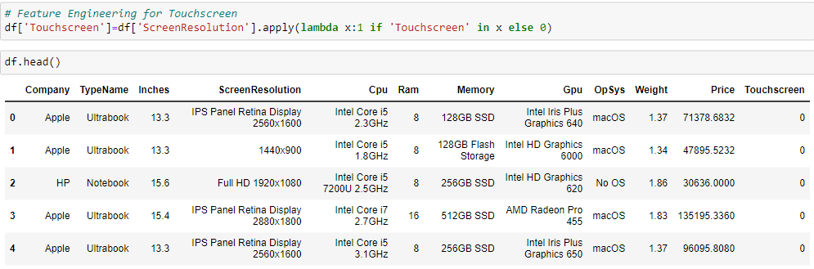
Extracting data from Screen Resolution column, named as Touchscreen column.

Slide 11
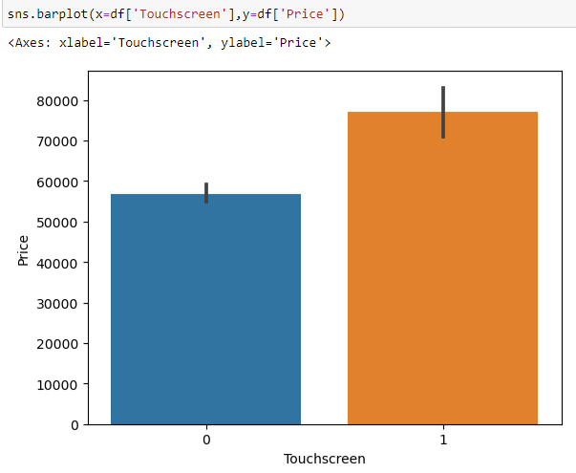
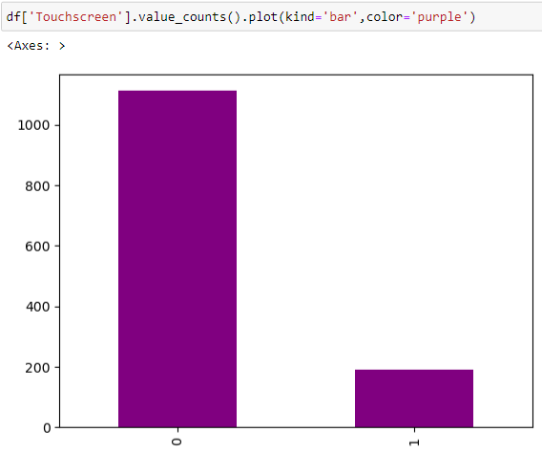
Comparing the Touchscreen column with the Target column.

Slide 12
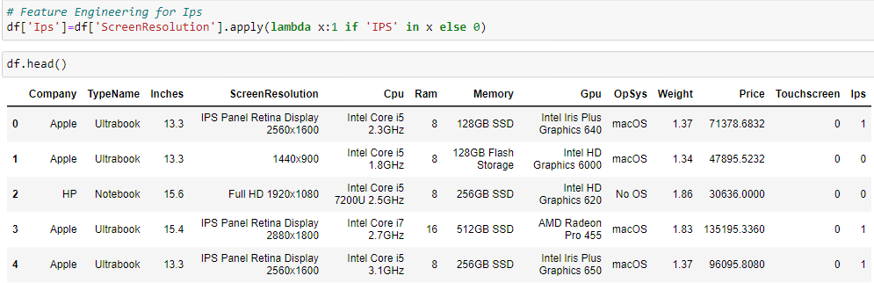
Extracting data from Screen Resolution column, named as Ips column.

Slide 13
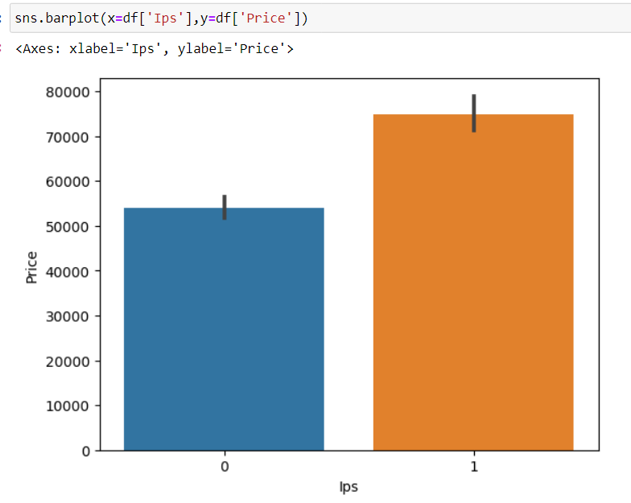
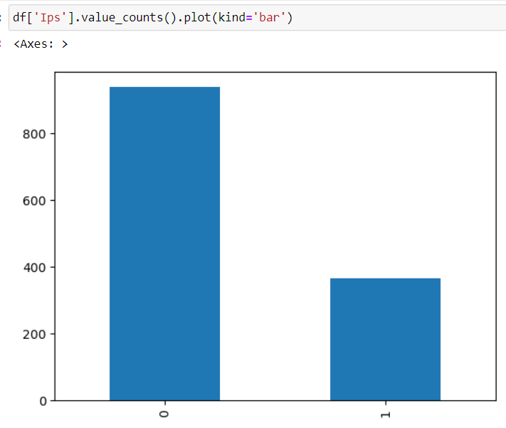
Comparing Ips column with the target column.

Slide 14
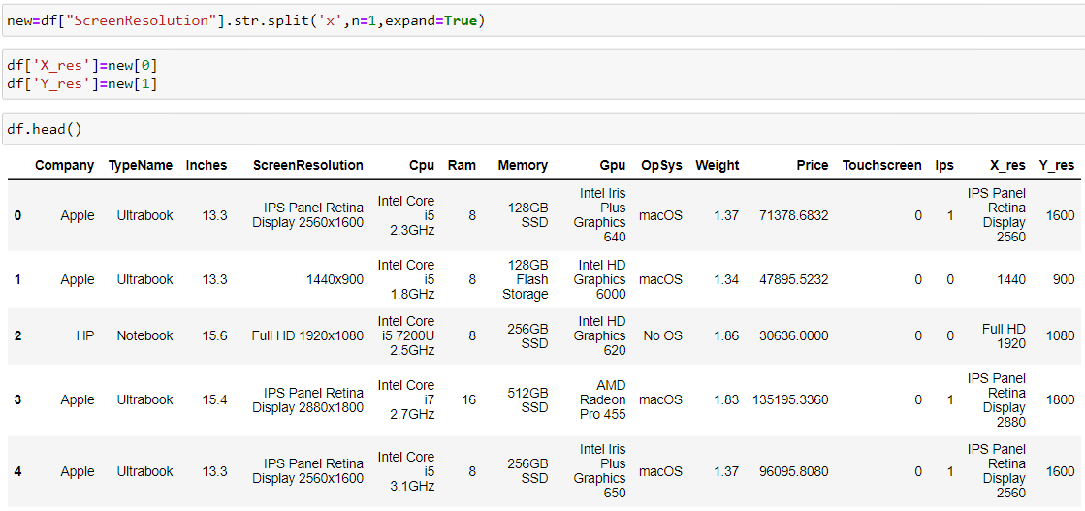
Extracting two new columns named as X res & Y res from Screen resolution.

Slide 15
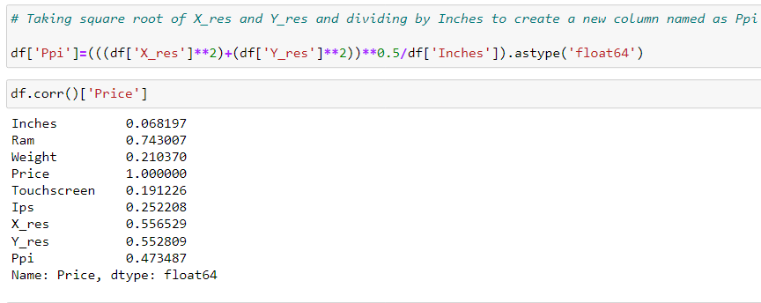
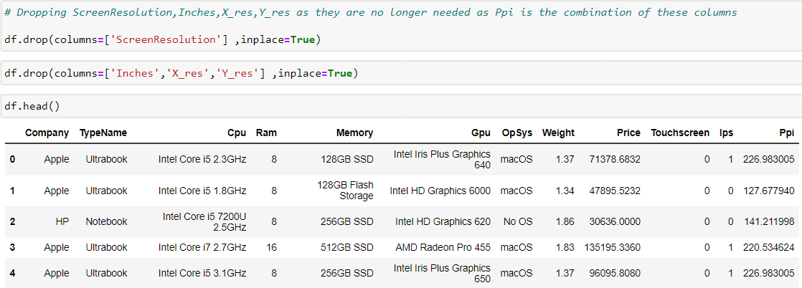
By taking the square root of X and Y and dividing by inches, a new column called Ppi is created.

Slide 16
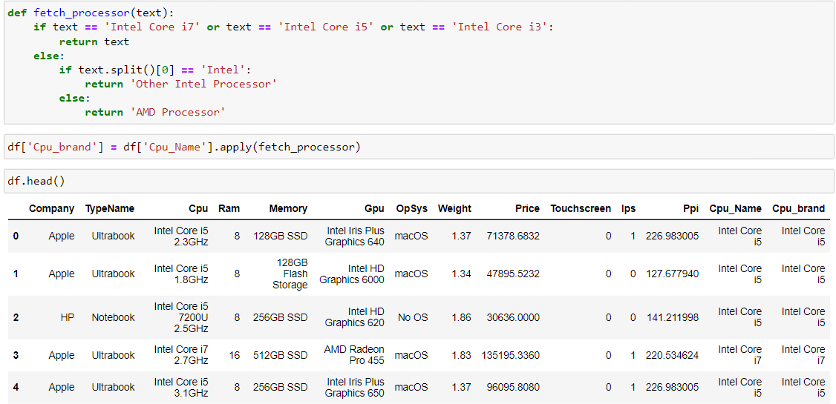
Creating a function to extract first three words from Cpu Name column and reassigning it as Cpu Brand.

Slide 17
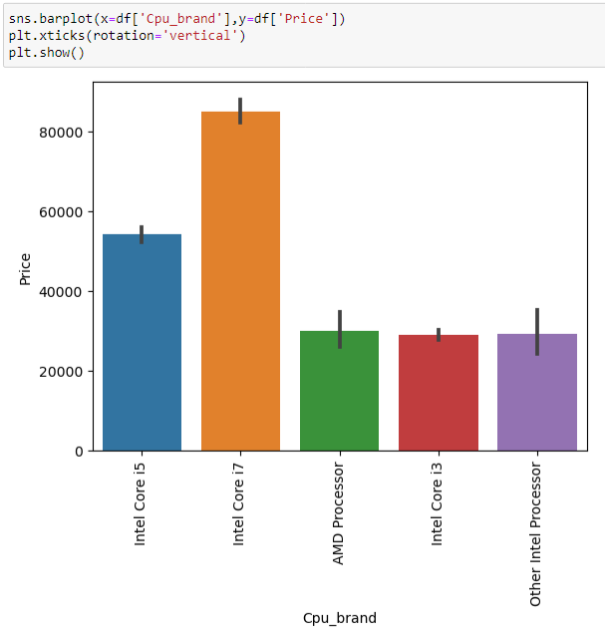
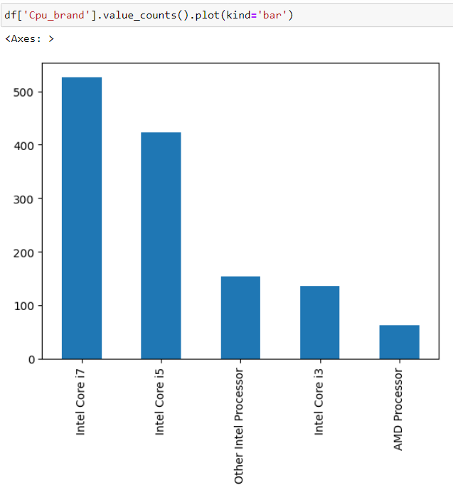
Comparing Cpu Brand column with the target column.

Slide 18
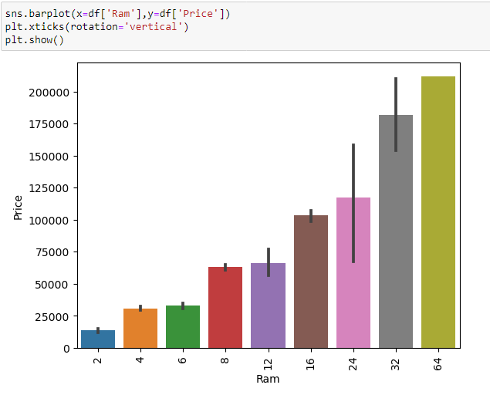
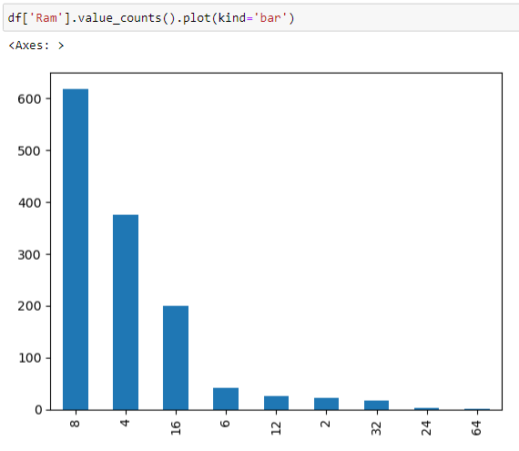
Comparing Ram column with the Target column.

Slide 19
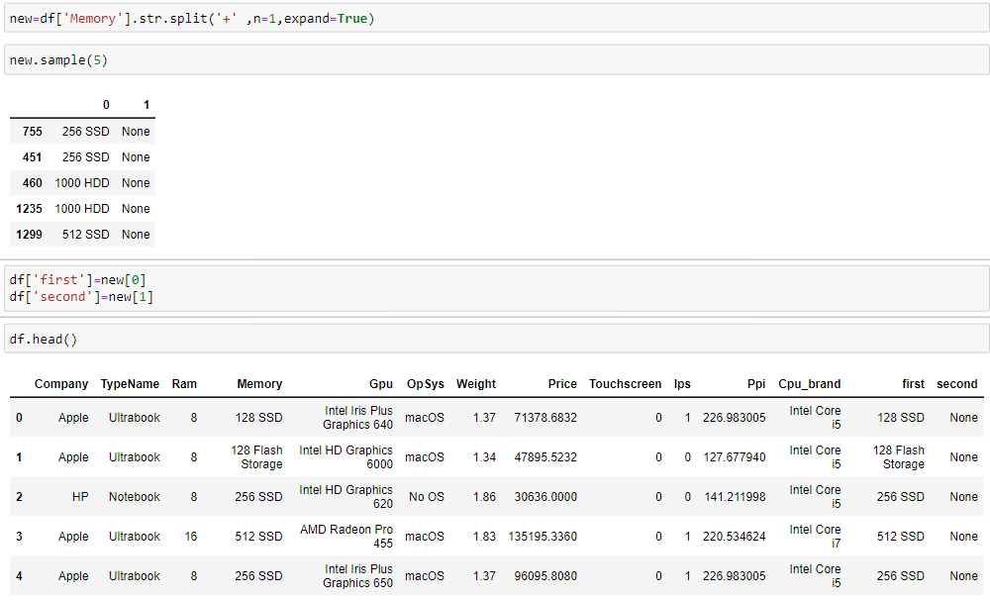
Splitting the memory column to separate the SSD & HDD, then allocating them as the first and second columns.

Slide 20
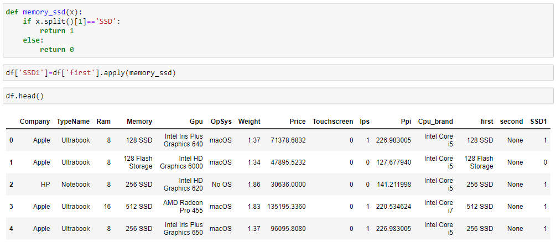
Creating a function to add the SSD column and following the same process for the HDD, Flash storage, and hybrid columns.

Slide 21
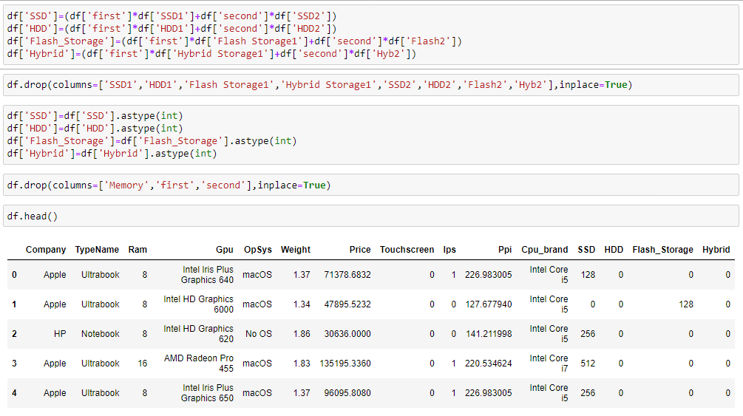
Extarcting SSD, HDD, Flash storage, Hybrid column from Memory column.

Slide 22
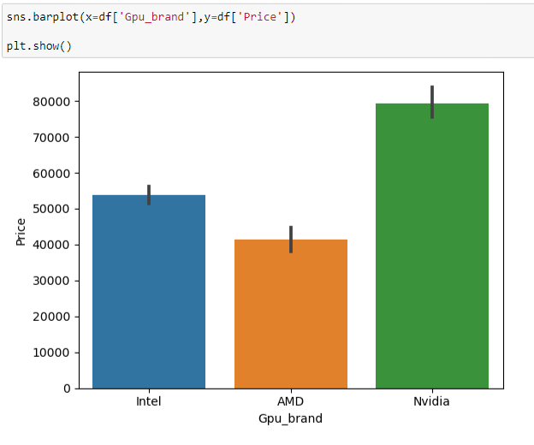
Comparing Gpu Brand with the target column.

Slide 23
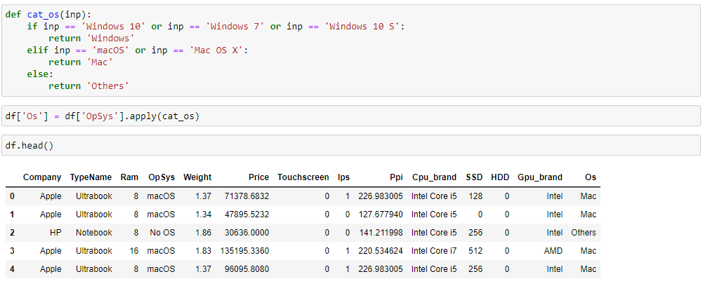
Creating a function to extract first word from OpSys column and reassigning it as OS.

Slide 24
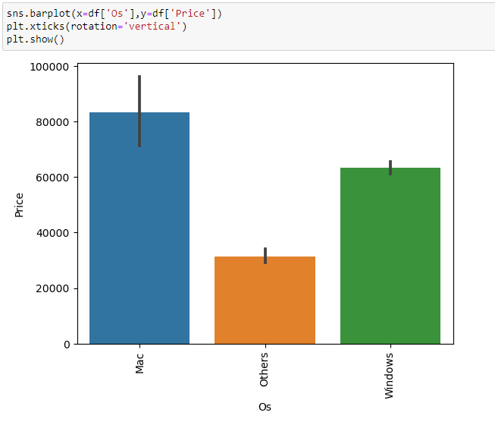
Comparing OS column with target column.

Slide 25
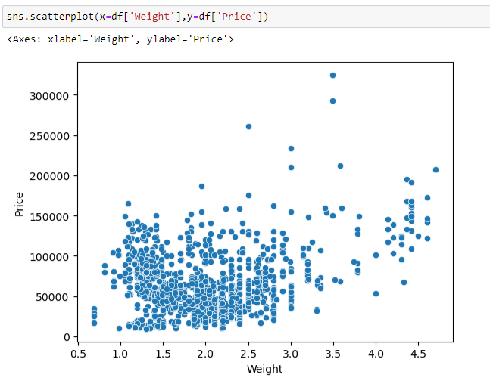
Plotting a scatterplot to check the difference between Weight & Price column.

Slide 26
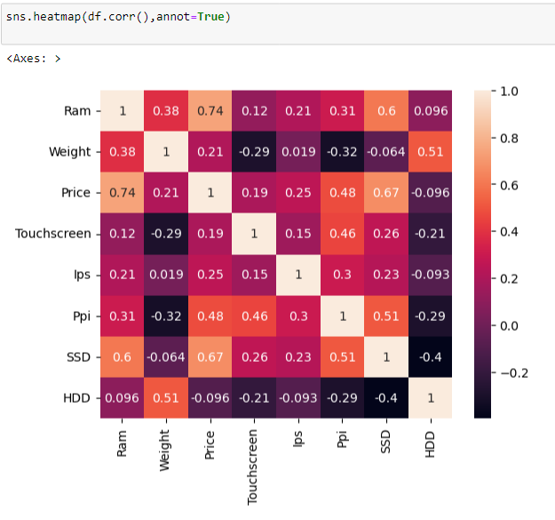
Heatmap
Correlation between variables

Slide 27
PREDICTIVE
MODELING

Slide 28
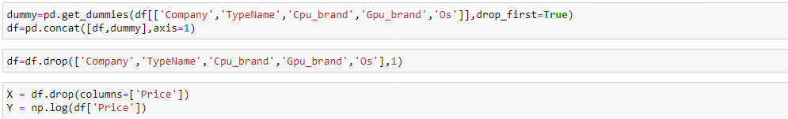
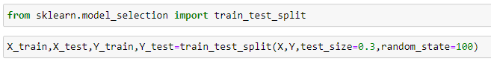
Obtaining dummy values for categorical data to transform into continuous variables.

Slide 29
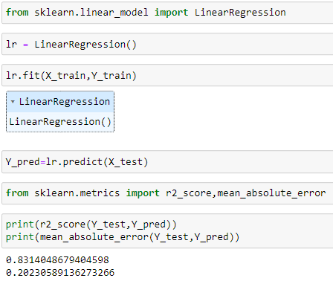
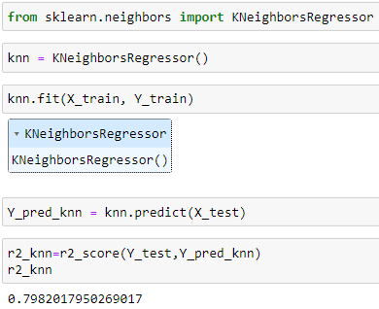
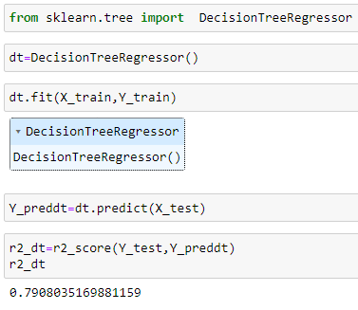
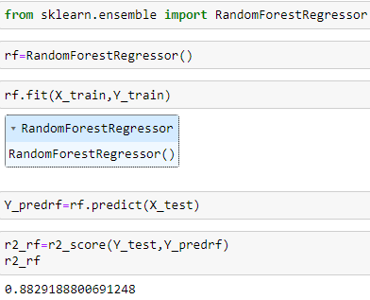
Linear Regression
2. K Nearest Neighbor
3. Decision Tree
4. Random Forest

Slide 30
THANK YOU !!!

